Slide 1

70-532: Azure Developers Solutions
Shyamal Pandya
Microsoft Specialist – Azure, MCP
Fb.com/shyamal.trainer

Slide 2
Points Consider In
- Hands on Exposure to Azure
E.g. How steps involved in creating Load
Balancer/Availability Set / VM etc.
57 Questions
700 Passing Marks
Few Que you can’t review back

Slide 3
For Detailed deep dive and interaction with Microsoft Product Team
https://docs.microsoft.com/en-us/azure/
https://mva.microsoft.com/
https://channel9.msdn.com/

Slide 4
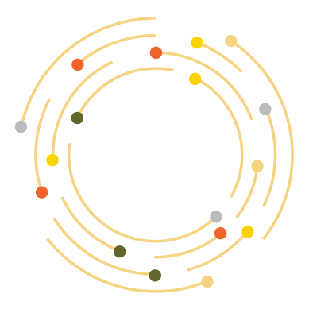

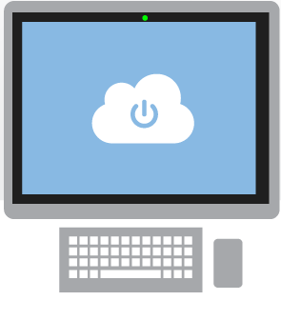
What is the cloud?
The practice of using a network of remote servers hosted on the Internet to store, manage, and process data, rather than a local server or a personal computer.
An approach to computing that’s about internet scale and connecting to a variety of devices and endpoints

Slide 5

Why the cloud?
Rapidly setup environments to drive business priorities
Scale to meet peak demands
Increase daily activities, efficiency and reduced cost.
Speed
Scale
Economics

Slide 6
What is Microsoft Azure?
Azure is Microsoft’s cloud computing platform, a growing collection of integrated services—analytics, computing, database, mobile, networking, storage, and web—for moving faster, achieving more, and saving money.

Slide 7
>57%
More than
1,000,000
>300k
Fortune 500 using Azure
Active websites
SQL Databases in Azure
>30
>300
>1.65
TRILLION storage objects
MILLION
AAD users
>3
MILLION requests/sec
>13
BILLION
MILLION
authentication/wk
Developers registered with Visual Studio Online

Slide 8
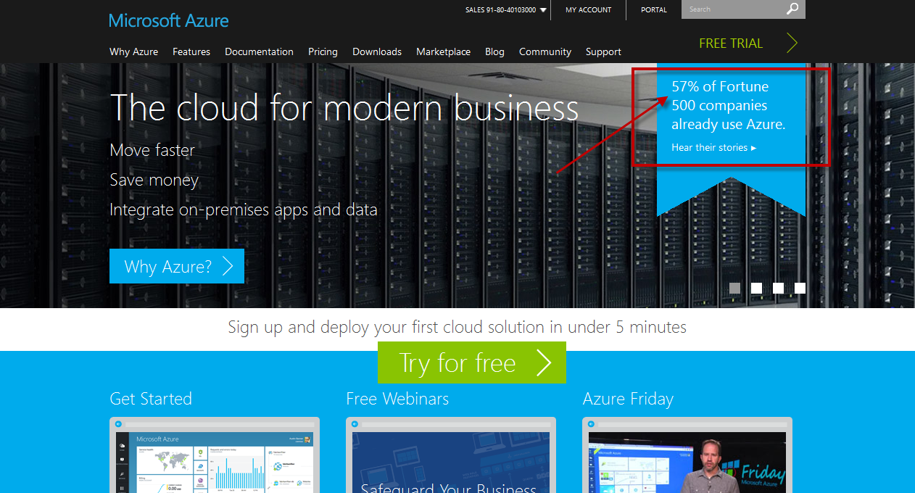

Slide 9





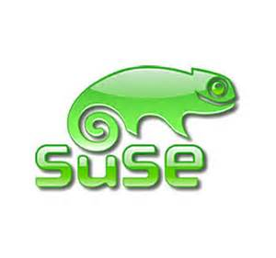




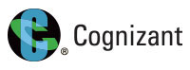









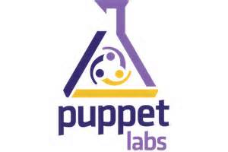












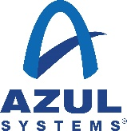















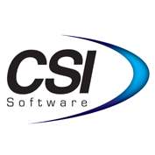




Partners

Slide 10
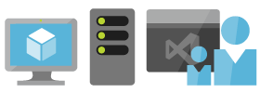
It delivers unmatched productivity
Any developer or IT professional can be productive with Azure. Azure’s integrated tools, pre-built templates, and managed services make it easier to build and manage enterprise, mobile, web, and Internet of Things (IoT) apps faster, using skills developers and IT professionals already have and technologies they already know.

Slide 11
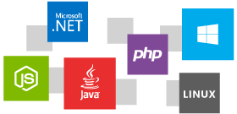
It’s open and flexible
Azure supports the broadest selection of operating systems, programming languages, frameworks, tools, databases and devices. Run Linux and Docker containers; build apps with JavaScript, Python, .NET, PHP, Java, Node.js; build backends for iOS, Android, and Windows devices. Azure supports the same technologies millions of developers and IT professionals already rely on and trust.

Slide 12
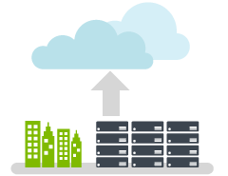
It works with existing IT

Slide 13

It’s built to protect your data

Slide 14

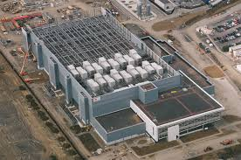
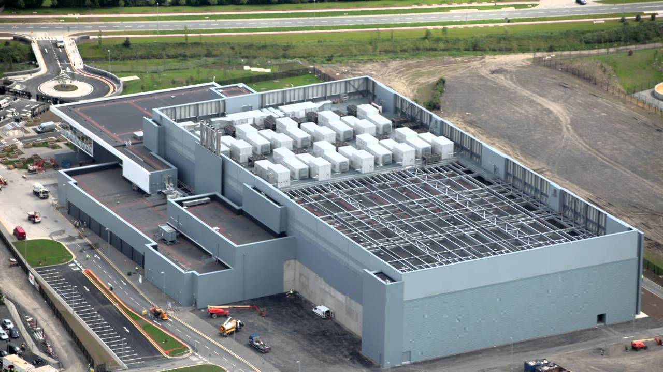
It’s everywhere

Slide 15
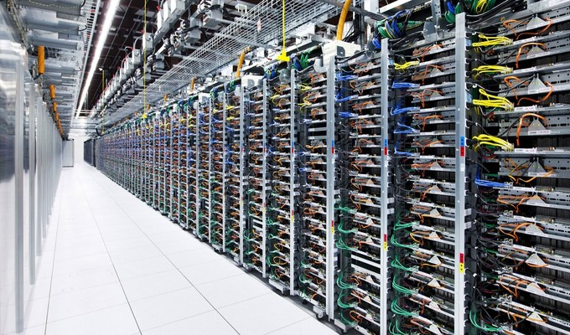


Slide 16
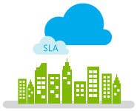
It’s ready for any business

Slide 17

It’s economical and scalable
Azure’s pay-as-you-go services can quickly scale up
or down to match demand, so you only pay for what you use.

Slide 18

It enables you to unlock insights
Azure’s predictive analytics services like Machine Learning, Power BI and Stream Analytics are redefining business intelligence. Make smarter decisions, improve customer service, and uncover new business possibilities from your structured, unstructured, and streaming Internet of Things data.

Slide 19



Cloud Computing
IaaS
PaaS
SaaS
Infrastructure-as-a-Service
Platform-as-a-Service
Software-as-a-Service
host
build
consume

Slide 20
Cloud Models
On Premises
Infrastructure
(as a Service)
Platform
(as a Service)
Software
(as a Service)
You manage
Applications
Applications
Applications
Applications
Data
You manage
Data
Data
Data
Runtime
Runtime
Runtime
Runtime
Managed by Microsoft
You manage
Middleware
Middleware
Middleware
Managed by Microsoft
Middleware
O/S
O/S
O/S
O/S
Managed by Microsoft
Virtualization
Virtualization
Virtualization
Virtualization
Servers
Servers
Servers
Servers
Storage
Storage
Storage
Storage
Networking
Networking
Networking
Networking
Notes:
Slide Objectives:
Explain the differences and relationship between IaaS, PaaS, and SaaS in more detail.
Speaking Points:
Here’s another way to look at the cloud services taxonomy and how this taxonomy maps to the components in an IT infrastructure.
Packaged Software
With packaged software a customer would be responsible for managing the entire stack – ranging from the network connectivity to the applications.
IaaS
With Infrastructure as a Service, the lower levels of the stack are managed by a vendor. Some of these components can be provided by traditional hosters – in fact most of them have moved to having a virtualized offering.
Very few actually provide an OS
The customer is still responsible for managing the OS through the Applications.
For the developer, an obvious benefit with IaaS is that it frees the developer from many concerns when provisioning physical or virtual machines.
This was one of the earliest and primary use cases for Amazon Web Services Elastic Cloud Compute (EC2).
Developers were able to readily provision virtual machines (AMIs) on EC2, develop and test solutions and, often, run the results ‘in production’.
The only requirement was a credit card to pay for the services.
PaaS
With Platform as a Service, everything from the network connectivity through the runtime is provided and managed by the platform vendor.
The Windows Azure best fits in this category today.
In fact because we don’t provide access to the underlying virtualization or operating system today, we’re often referred to as not providing IaaS.
PaaS offerings further reduce the developer burden by additionally supporting the platform runtime and related application services.
With PaaS, the developer can, almost immediately, begin creating the business logic for an application.
Potentially, the increases in productivity are considerable and, because the hardware and operational aspects of the cloud platform are also managed by the cloud platform provider, applications can quickly be taken from an idea to reality very quickly.
SaaS
Finally, with SaaS, a vendor provides the application and abstracts you from all of the underlying components.

Slide 21
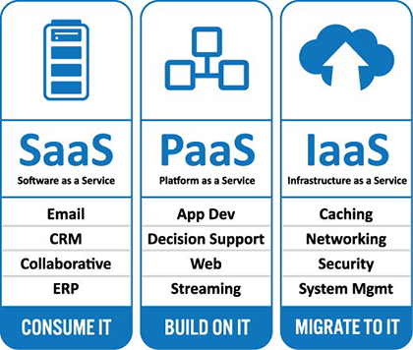
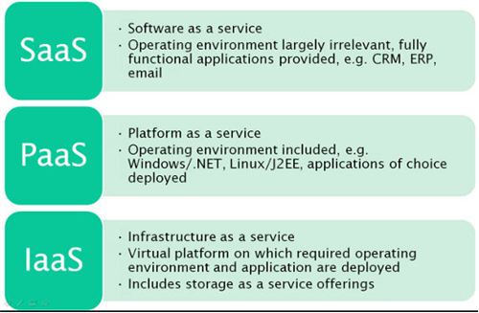

Slide 22
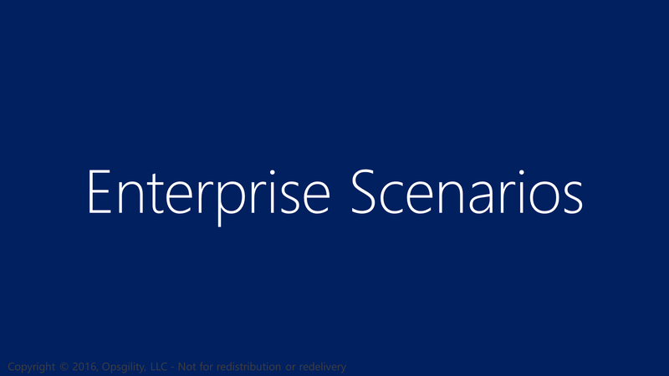
Enterprise Scenarios

Slide 23
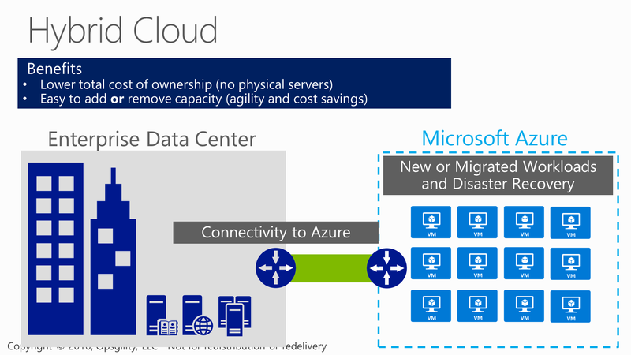
Hybrid Cloud

Slide 24
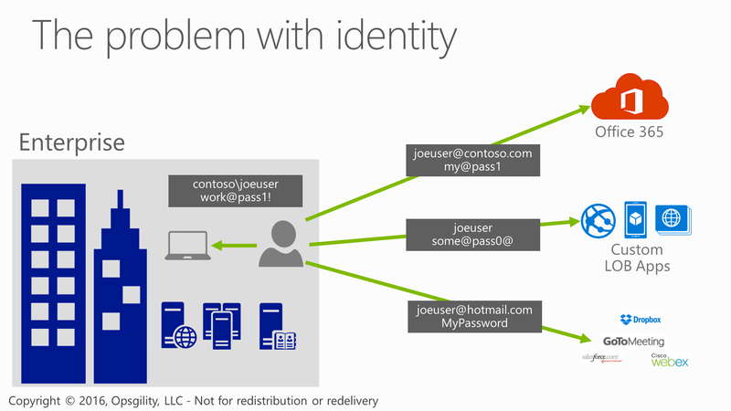
The problem with identity
Notes:
Traditionally Active Directory had solved the issues of having one user name and password. With the proliferation of the internet and services from Cloud providers this has become a huge issues for enterprises. Today people have many user names and leverage services across the web to get their jobs done.

Slide 25
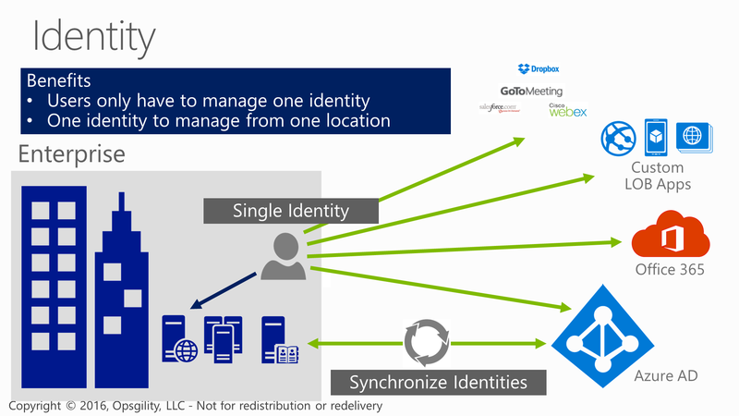
Identity
Notes:
Using Azure AD and Active Directory together Microsoft has an Enterprise grade turn key solution to these issues. Now corporations can provide access across thousands of website or corporate apps using just the credentials provisioned or removed from Active Directory.

Slide 26
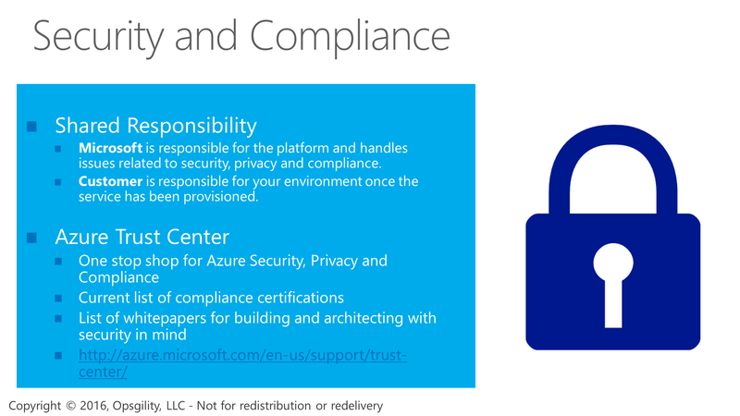
Security and Compliance
Notes:
Microsoft has a long history of running data centers going all the way back to 1989 when the first launched MSN. Microsoft also has a very vested interest in security – going back to 2004 with the implementation of the security development lifecycle due to attacks like Code Red and Slammer where they reorganized their entire software development lifecycle to integrate security as a core tenant.
Visiting the Azure trust center you can see the compliance certifications, the contractual obligations they are under and the details on how they physically and virtually secure the Microsoft Azure data centers.

Slide 27
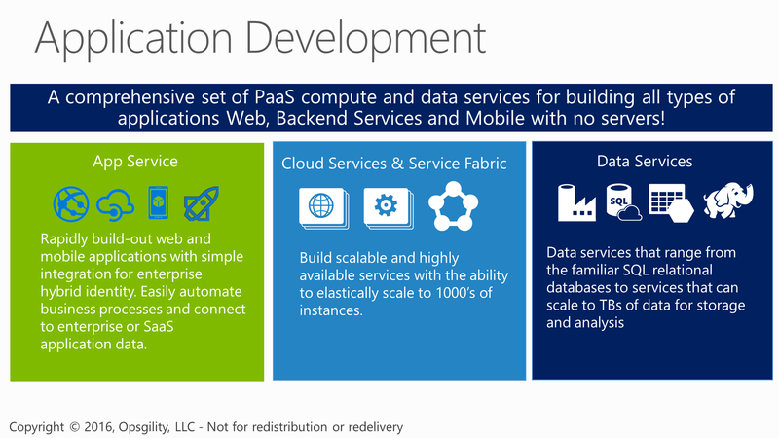
Application Development

Slide 28
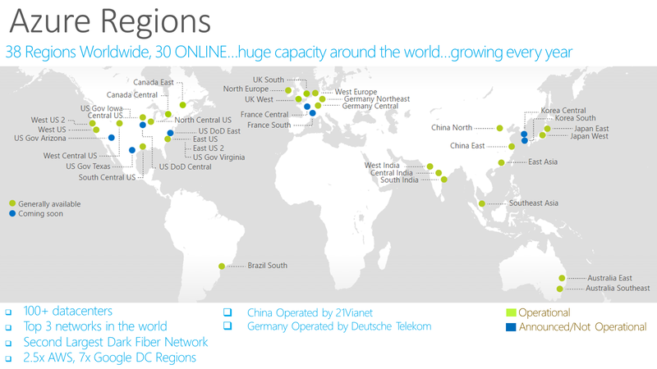
Notes:
https://azure.microsoft.com/en-us/regions/
Over the last few years we’ve truly delivered a huge infrastructure to enable us to grow our services at scale around the globe. Whether it’s our flagship facilities in Quincy, Washington or Boydton, Virginia, or some of the newly announced facilities in Shanghai, Australia and Brazil, it really is key for us to make smart investments around the world to deliver services in a resilient and reliable fashion.
A lot of people ask, what goes into site selection at Microsoft and how do we decide where to place our datacenter investments? There are over thirty-five factors in our site selection criteria. But really, the top elements are around proximity to customers and energy and fiber infrastructure, insuring that we have the capacity and the growth platforms to be able to grow our services.
Another key element is about skilled workforce. We need to insure that we have the right people to run and operate our datacenters on a day to day basis.

Slide 29
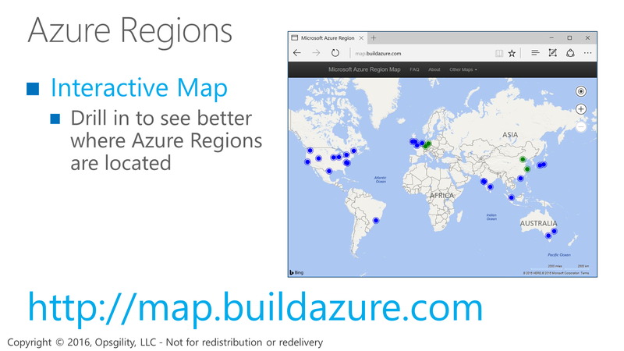
Azure Regions

Slide 30
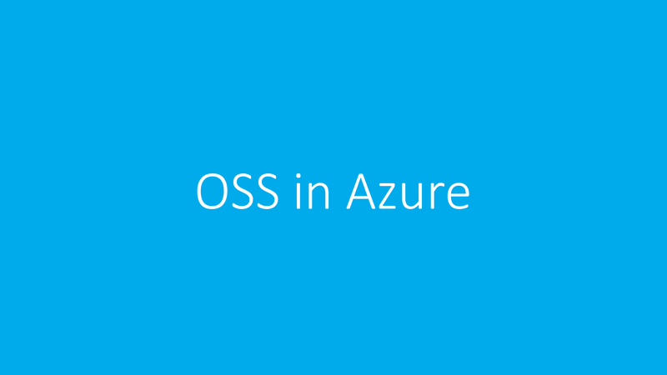
OSS in Azure

Slide 31
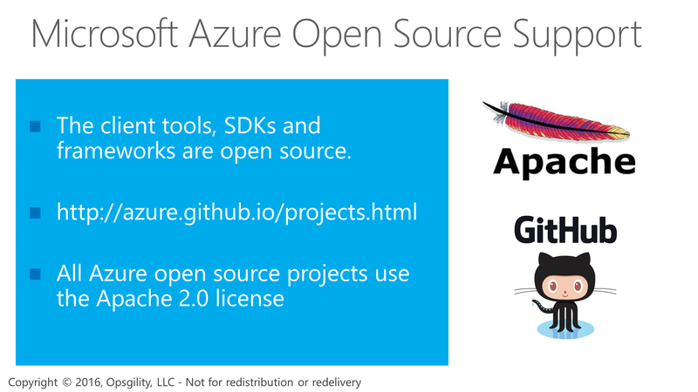
Microsoft Azure Open Source Support

Slide 32
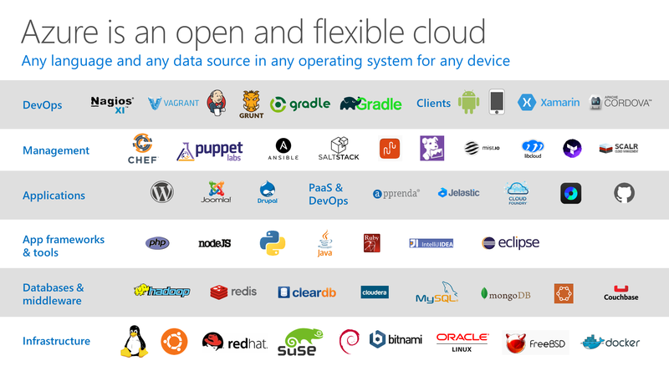
Notes:
P2

Slide 33
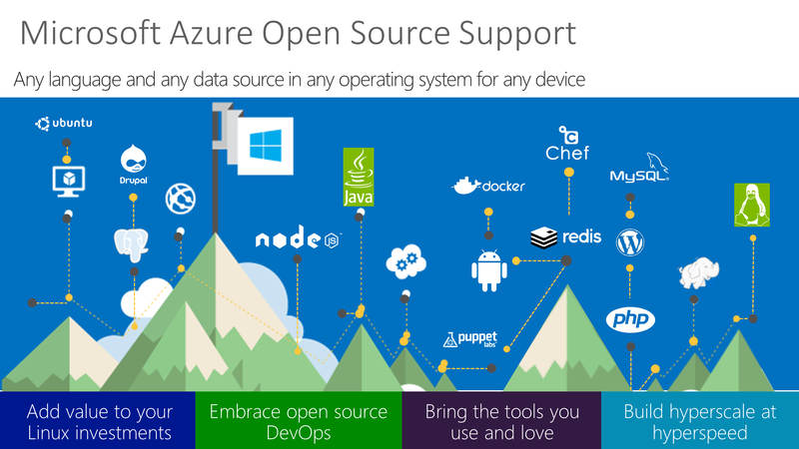
Microsoft Azure Open Source Support

Slide 34
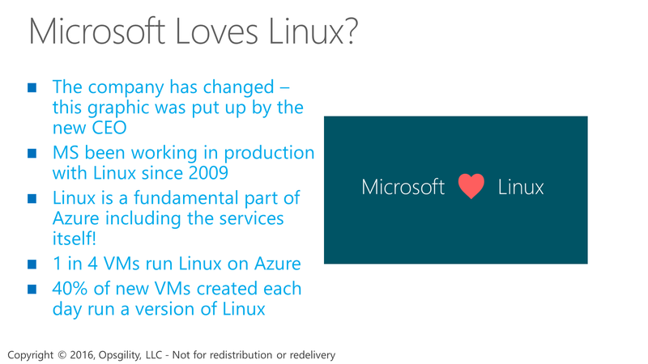
Microsoft Loves Linux?

Slide 35
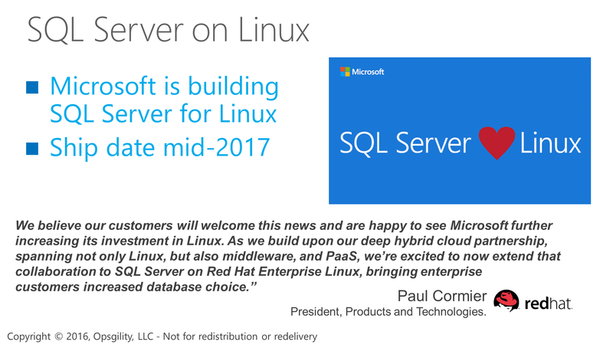
SQL Server on Linux

Slide 36
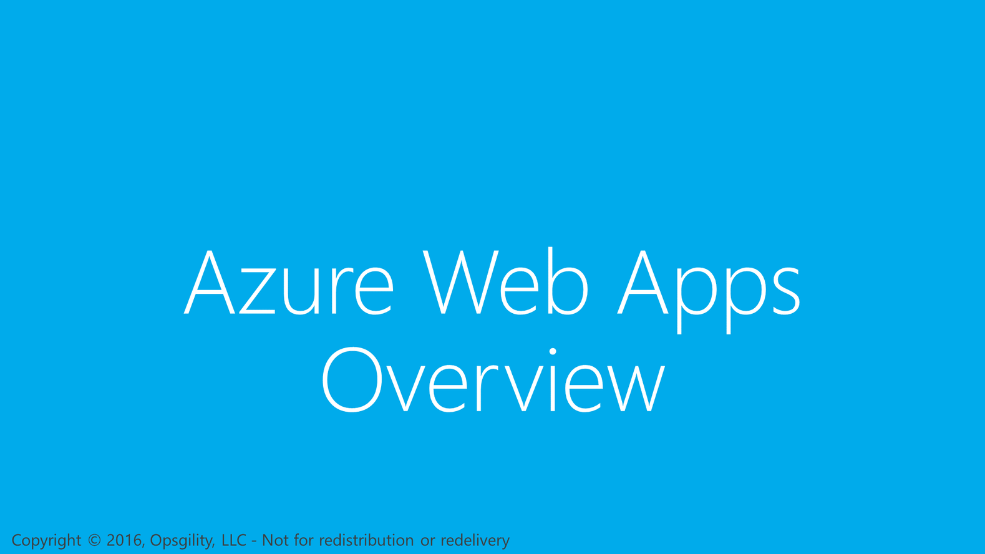
Azure Web Apps Overview

Slide 37
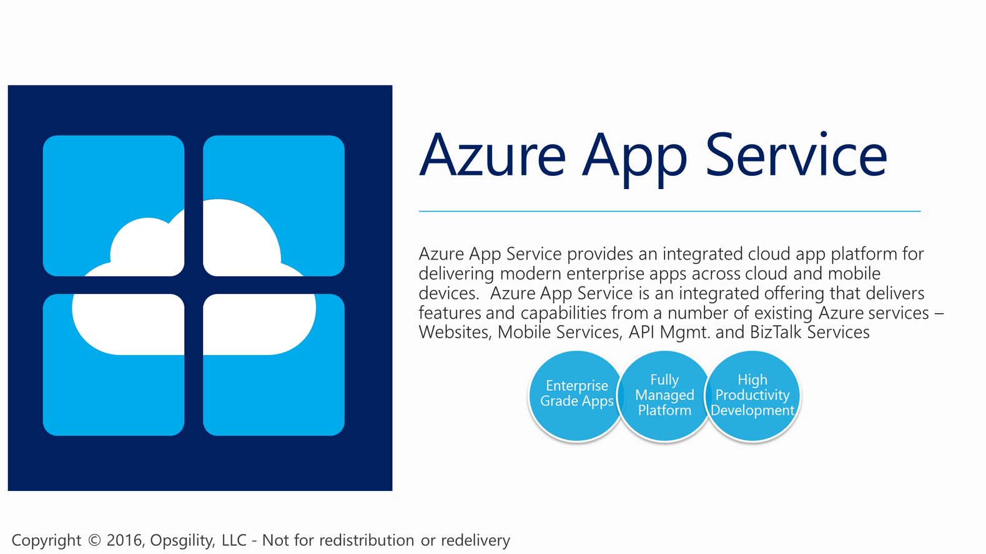

Slide 38
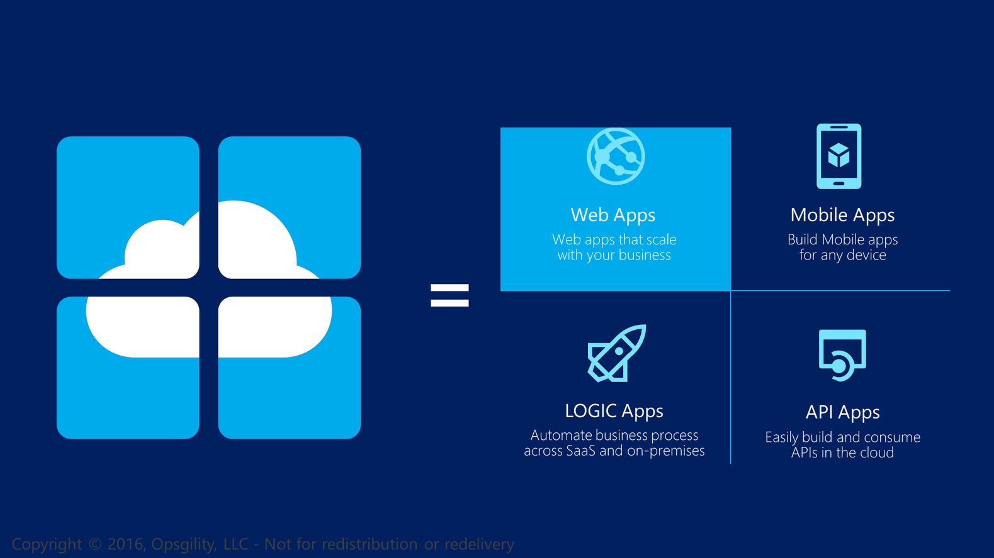
Notes:
API App – Deploy your own APIs into this offering to host and expose them for use with you custom applications
Logic App - Logic Apps provide a way to simplify and implement scalable integrations and workflows in the cloud. It provides a visual designer to model and automate your process as a series of steps known as a workflow. A logic app begins with a trigger (like 'When an account is added to Dynamics CRM') and after firing can begin many combinations actions, conversions, and condition logic.

Slide 39
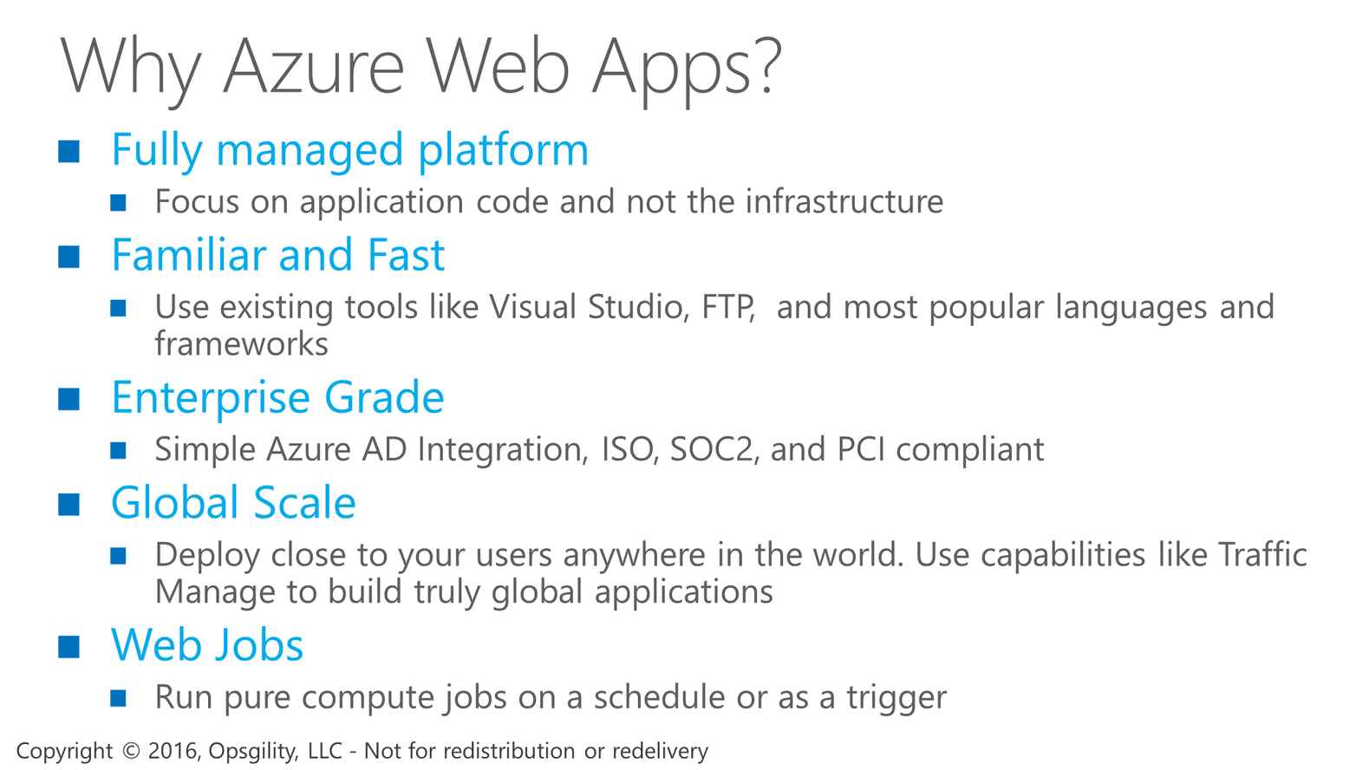
Why Azure Web Apps?
Notes:
You can run programs or scripts in WebJobs in your App Service web app in three ways: on demand, continuously, or on a schedule.
Azure Functions is another way to run programs and scripts in Azure App Service.
Web Jobs can be used to support Web, API, and Mobile apps

Slide 40
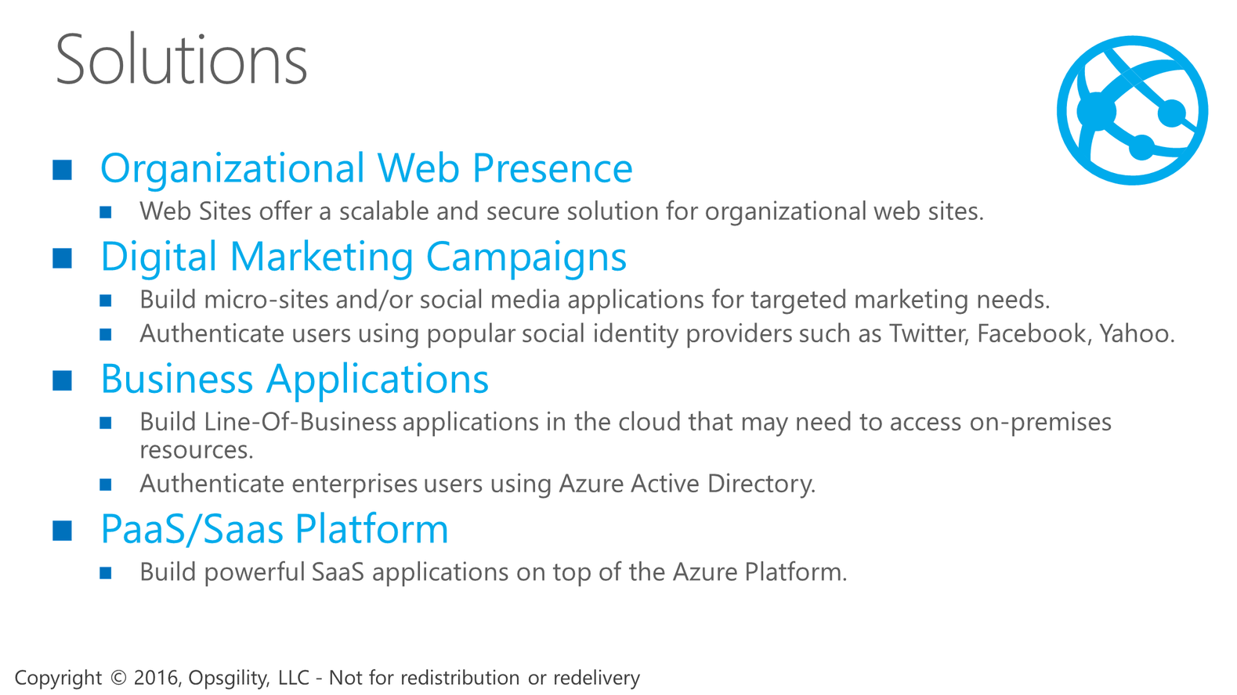
Solutions

Slide 41
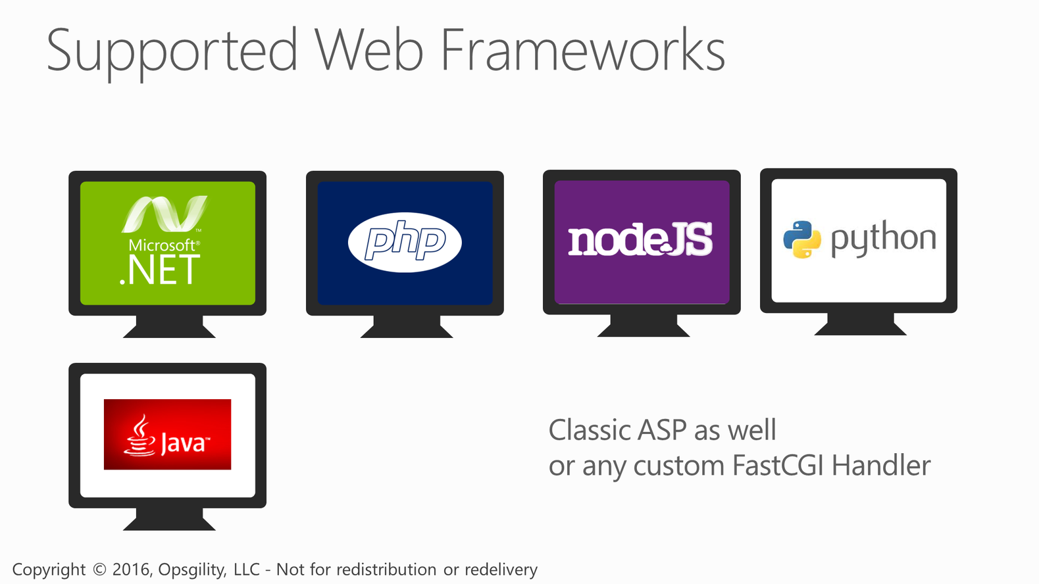
Supported Web Frameworks
Notes:
With websites you can deploy applications built on Classic ASP, ASP.NET, PHP, Python, Java, and Node.js. You do not have to worry about the runtime itself because it is built in to the platform.
Any framework that supports using the FastCGI handler in IIS is also supported.

Slide 42
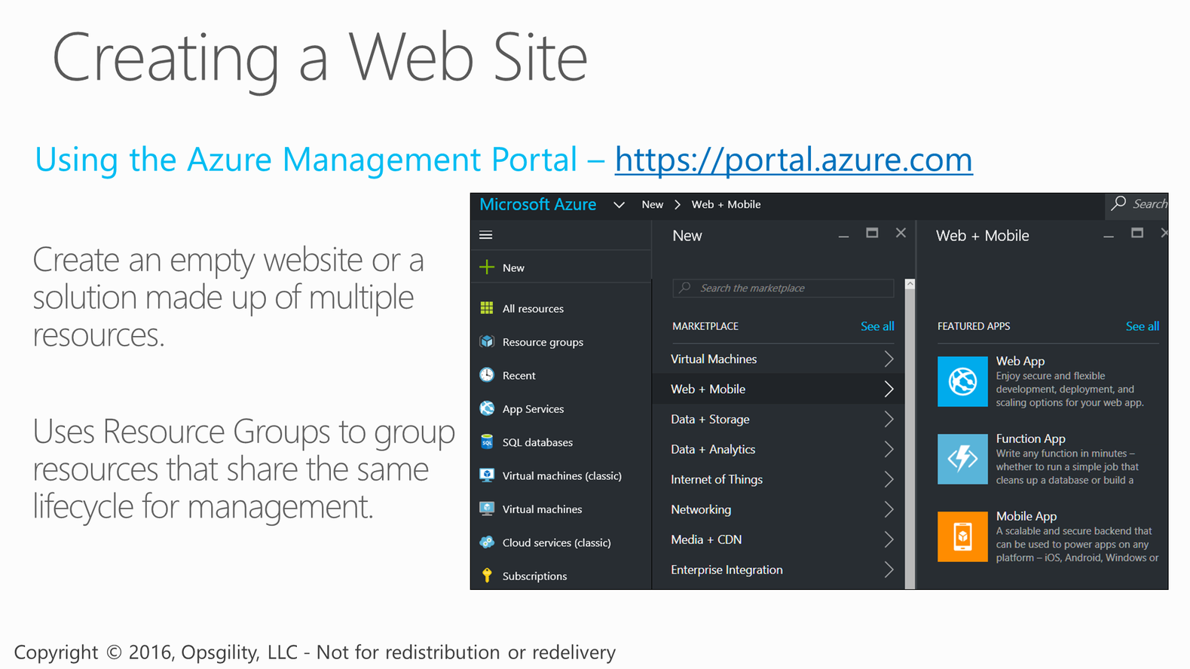
Creating a Web Site

Slide 43
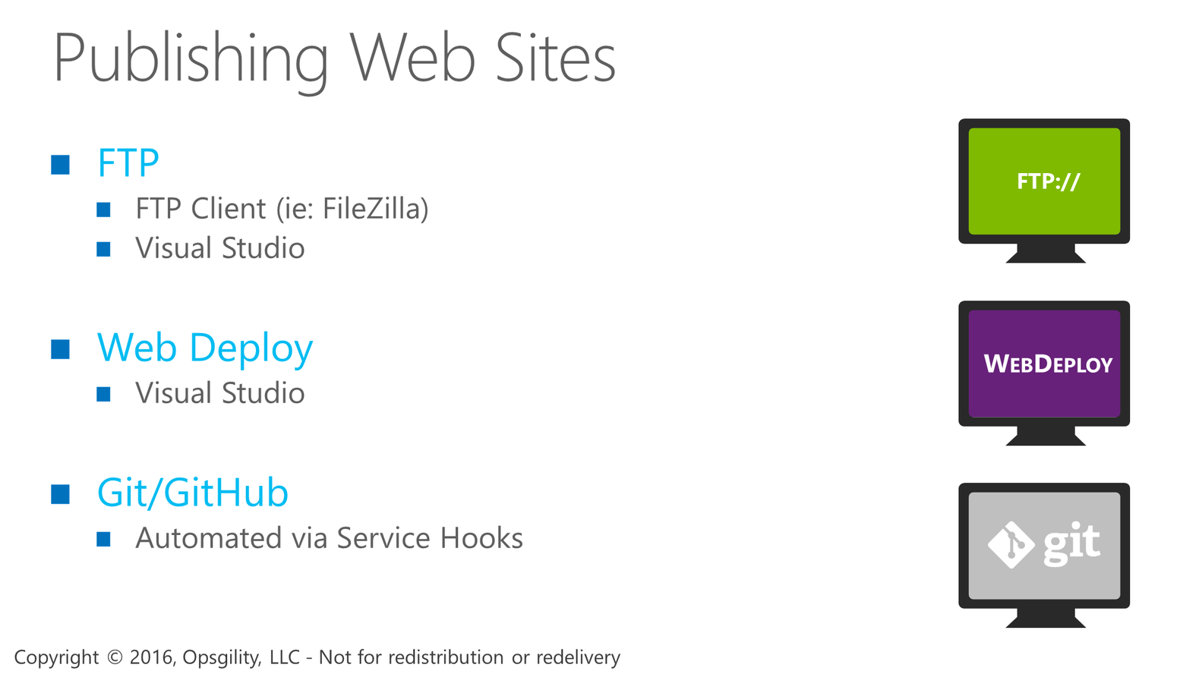
Publishing Web Sites

Slide 44
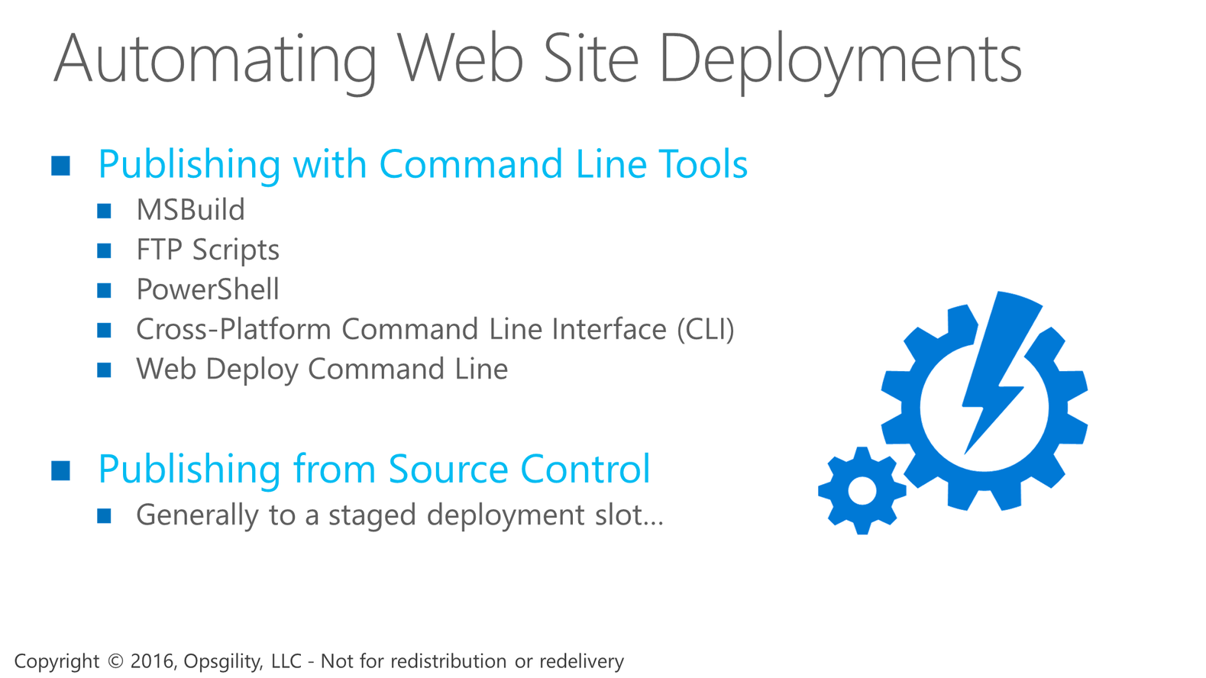
Automating Web Site Deployments

Slide 45
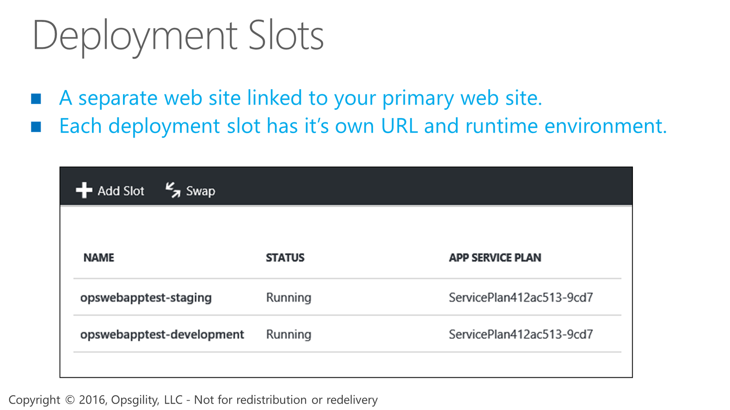
Deployment Slots

Slide 46
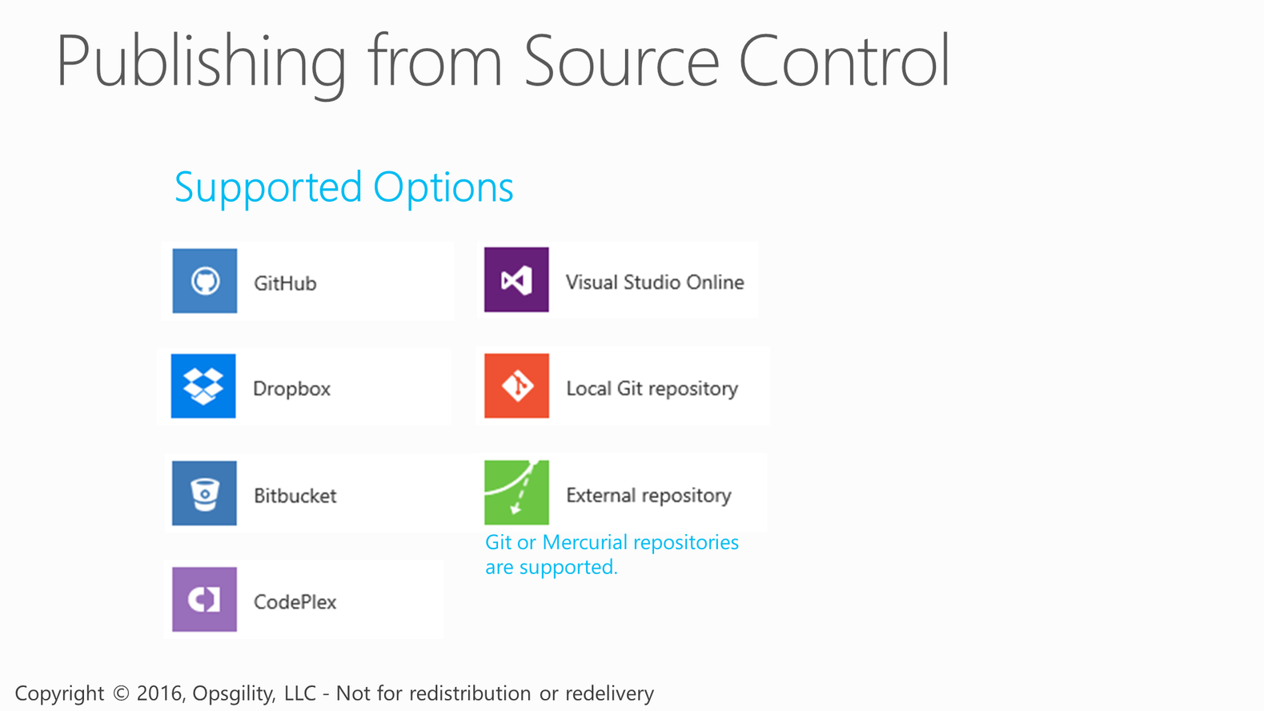
Publishing from Source Control
Notes:
Website deployment is all about being agile and flexible. Whether you just want to simply FTP your content for deployment or deploy with more advanced continuous integration using applications like TFS, WebDeploy, Git or even dropbox there are plenty of options.
GitHub, CodePlex and BitBucket are also supported using a Git service hook.
Windows Azure Websites have recently introduced the concept of a staging site and a swap feature. Similar to cloud services you can also deploy to staging, verify the new deployment is valid and then swap to production.

Slide 47
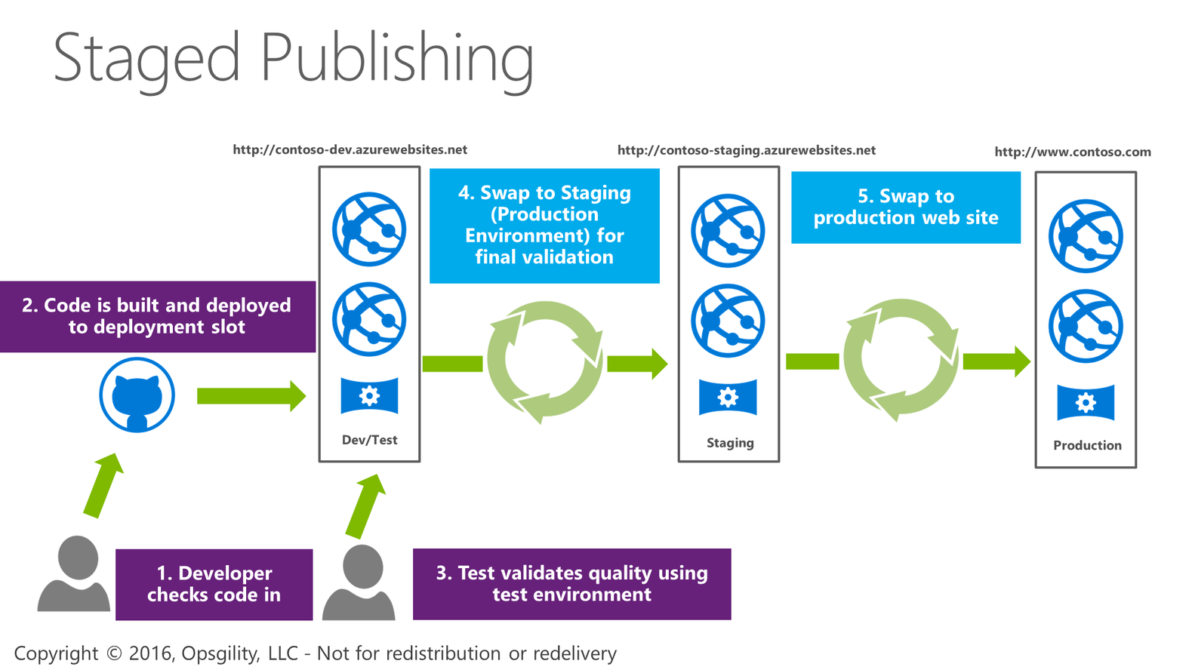
Staged Publishing

Slide 48
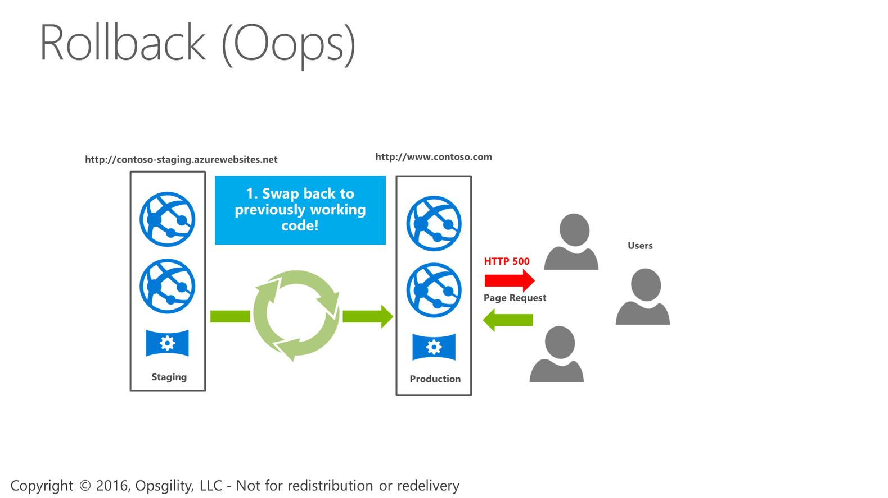
Rollback (Oops)

Slide 49
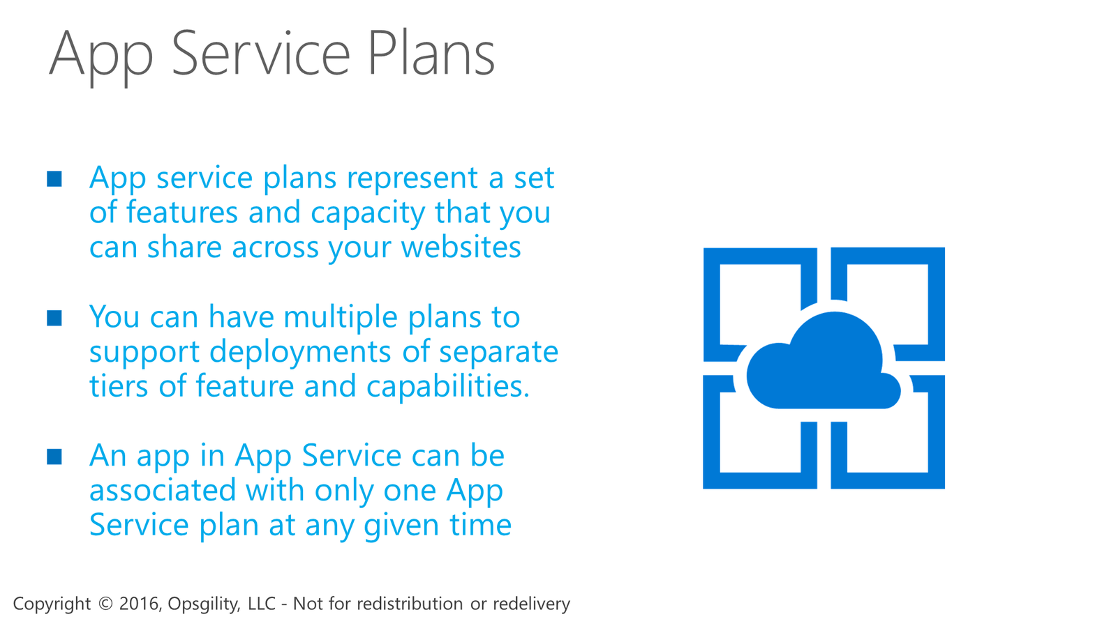
App Service Plans

Slide 50
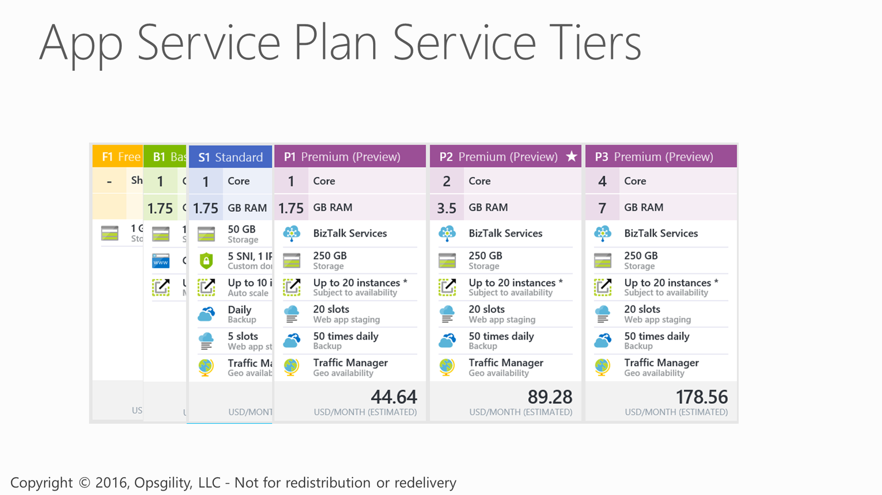
App Service Plan Service Tiers

Slide 51
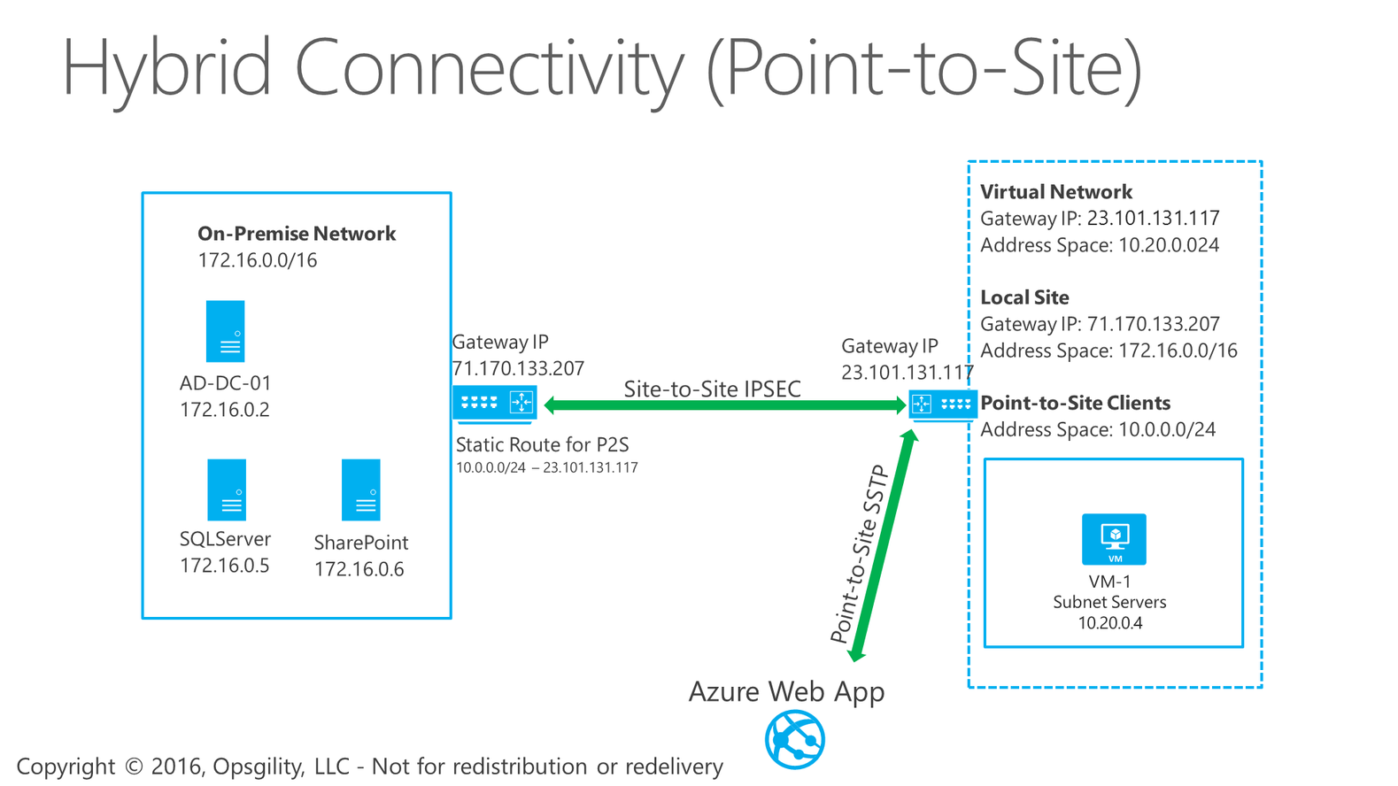
Hybrid Connectivity (Point-to-Site)
Notes:
A common scenario where you would use VNET Integration is enabling access from your web app to a database or a web services running on a virtual machine in your Azure virtual network. With VNET Integration you don't need to expose a public endpoint for applications on your VM but can use the private non-internet routable addresses instead.
Use cases:
Code deployment from pn-prem
Access datatier in Azure vnet on IaaS VM

Slide 52
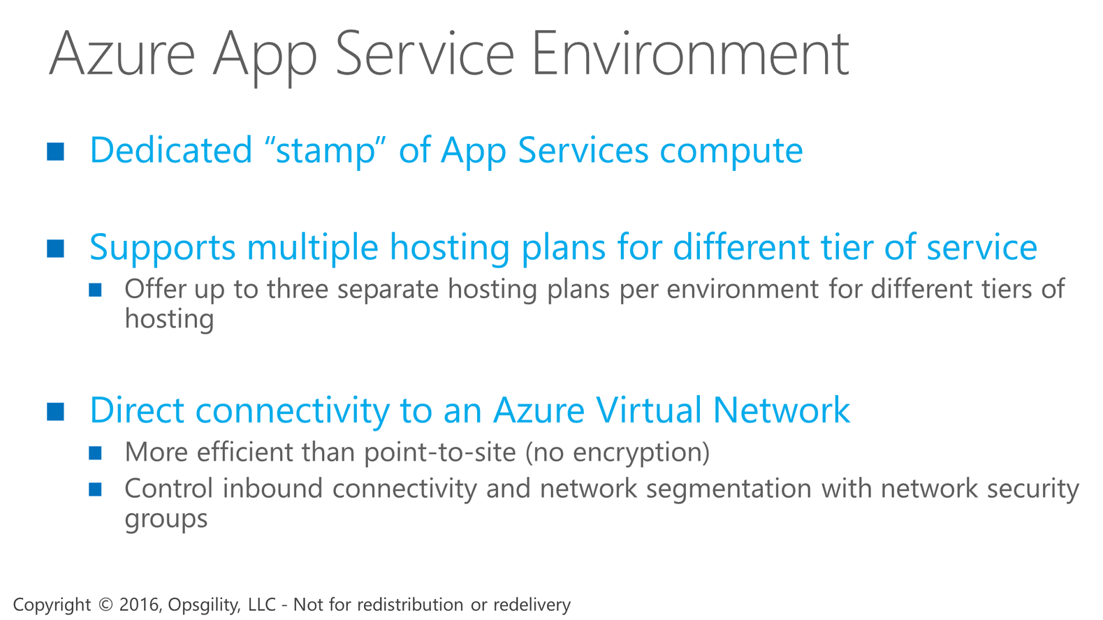
Azure App Service Environment
Notes:
An App Service Environment is a Premium service plan option of Azure App Service that provides a fully isolated and dedicated environment for securely running Azure App Service apps at high scale, including Web Apps, Mobile Apps, and API Apps.
App Service Environments are ideal for application workloads requiring:
Very high scale
Isolation and secure network access
App Service Environments are isolated to running only a single customer's applications, and are always deployed into a virtual network. Customers have fine-grained control over both inbound and outbound application network traffic, and applications can establish high-speed secure connections over virtual networks to on-premises corporate resources.

Slide 53
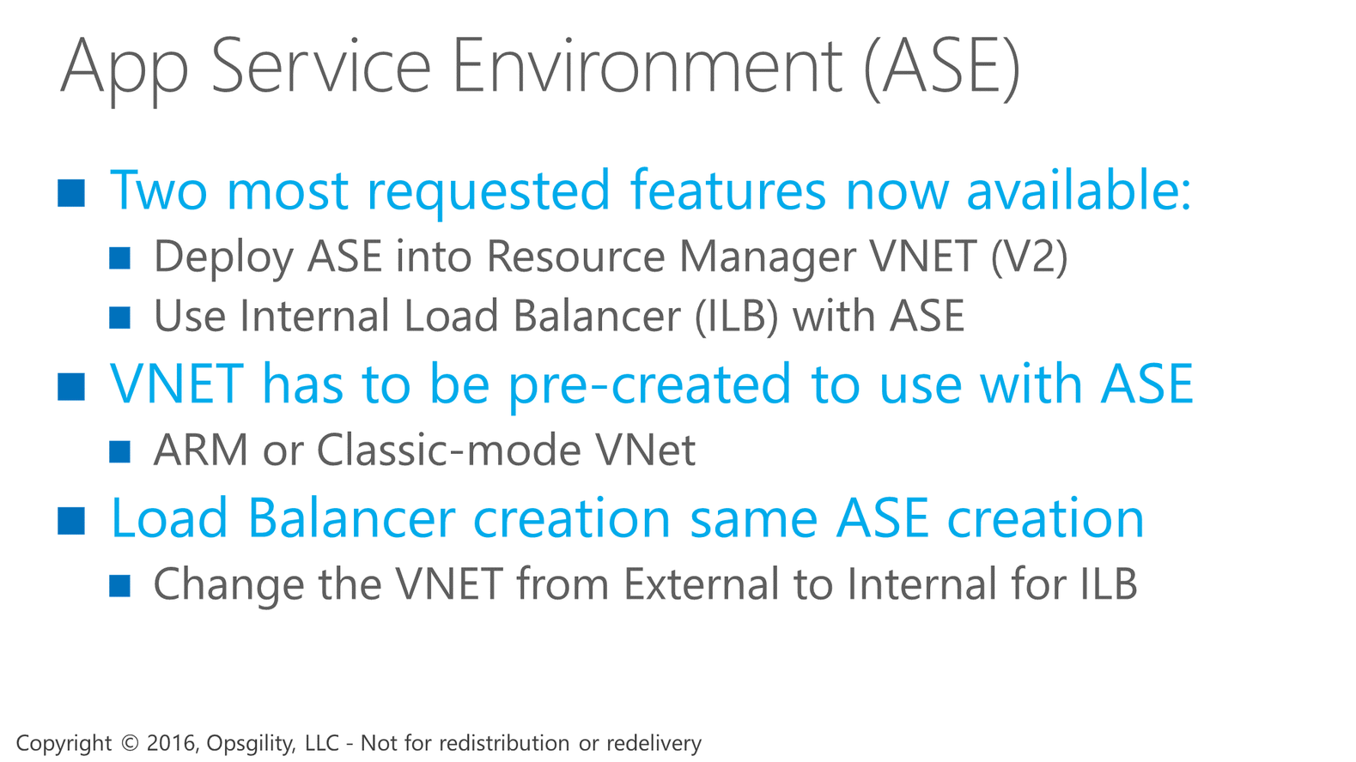
App Service Environment (ASE)
Notes:
The differences between an ILB ASE and a normal ASE
In a normal ASE all the traffic to the ASE comes in from an internet accessible VIP.
The domain names for your apps in that ASE point to the VIP so all request and publishing access goes through the VIP. You can use network security groups to lock down access to your ASE and even use a WAF with your ASE. The domain names for your apps though are in Azure DNS and are public. So what is the solution if you want to host say, your time tracking app or your invoice processing app on an ASE? You probably don’t want to make that internet accessible in any possible way. This is where the ILB ASE can really shine.
With an ILB the endpoint is on an IP in your Azure VNet. On top of that, you own your own subdomain. Sure this means you need to manage your own DNS and HTTPS for the site but, it’s all under your control and in your network space, not the internet. If you have stringent security requirements, then most likely they are met with an ILB ASE.
On top of hosting your intranet apps securely in an ASE you also can use an ILB ASE for multi-tier applications. There are a number of customer application needs where customers want an internet isolated API capability. In such a scenario you can have an internet accessible ASE that makes calls to the ILB ASE that don’t traverse the internet.

Slide 54
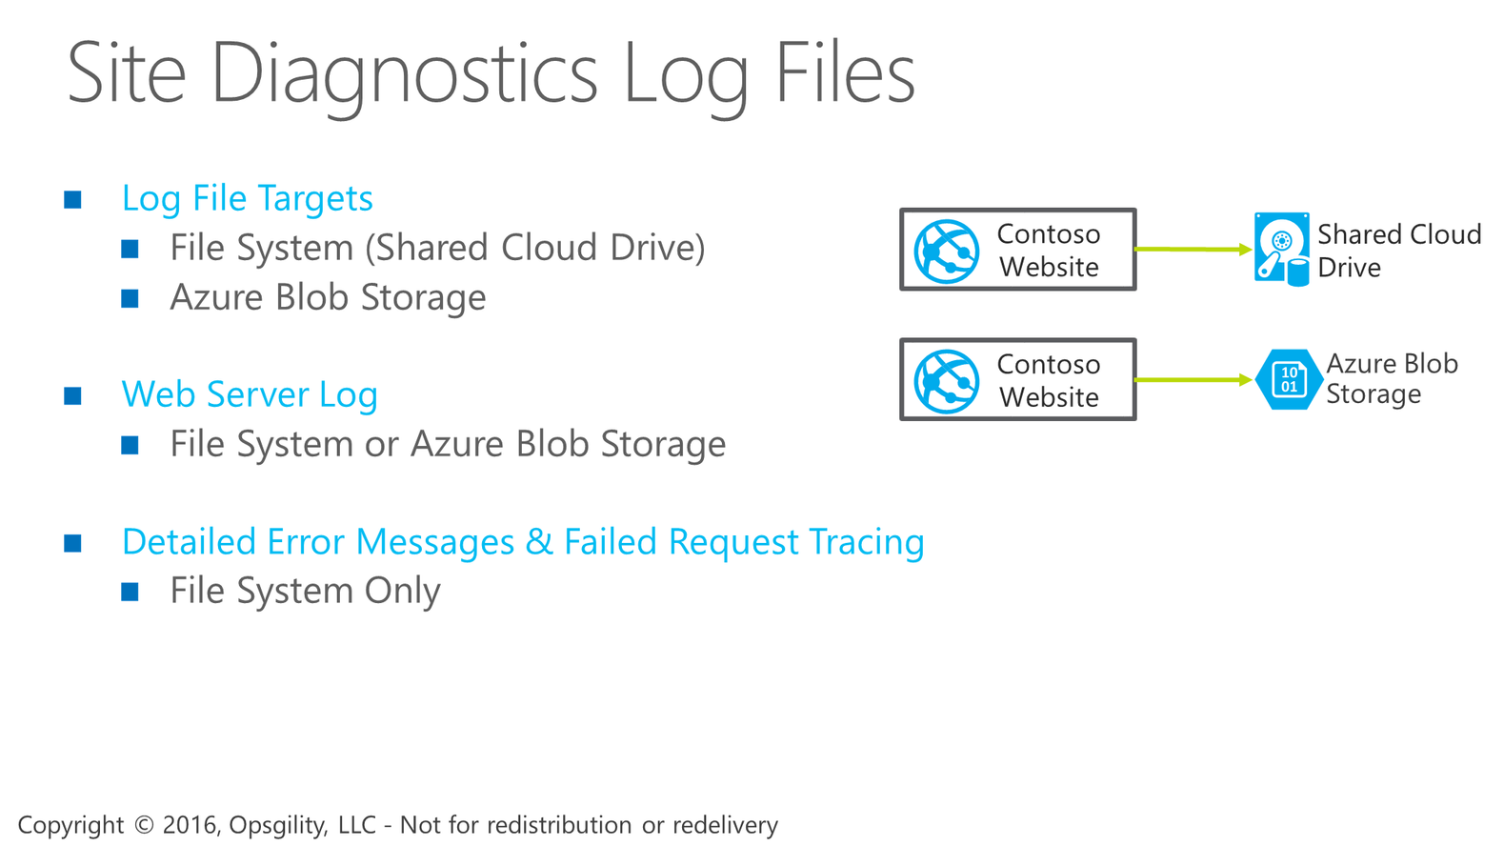
Site Diagnostics Log Files
Notes:
App Service web apps provide diagnostic functionality for logging information from both the web server and the web application. These are logically separated into web server diagnostics and application diagnostics.

Slide 55

Site Diagnostics Log Files

Slide 56

Application Diagnostic Log Files

Slide 57

Live-Streaming Diagnostic Logs

Slide 58

Azure Compute Services Landscape
Notes:
Notes
If you are new to cloud computing you will hear a lot of talk about different terms like Platform as a Service, Infrastructure as a Service, and Software as a Service.
Let me clarify what these terms and categories mean in more detail.
Infrastructure as a Service or IaaS – a set of infrastructure level capabilities such as an operating system, network connectivity, etc. that are delivered as pay for use services and can be used to host applications or server workloads. In Azure, virtual machines and virtual networks are the primary workloads with IaaS.
Platform as a Service or PaaS – higher level sets of functionality that are delivered as consumable services for developers who are building applications. PaaS is about abstracting developers from the underlying infrastructure to enable applications to quickly be composed. In Azure there are several PaaS services - such as Cloud Services, Service Fabric, App Service (Web Apps), Storage and SQL Database.
Software as a Service or SaaS – applications that are delivered using a service delivery model where organizations can simply consume and use the application. Typically an organization would pay for the use of the application or the application could be monetized through ad revenue. A great example of a SaaS based application is Office 365.

Slide 59

Infrastructure as a Service in Azure
Notes:
The building blocks of Azure IaaS are:
Virtual Machines – Azure has lots of options for their VMs including the largest VMs in the Public Cloud
Virtual Networks – These provide the networking capabilities to support working with Azure Services and Hybrid Cloud
And many supporting services such as Storage, Azure Site Recovery, DNS Services etc.
What is Azure Site Recovery - You replicate servers and VMs from your primary on-premises datacenter to the cloud (Azure), or to a secondary datacenter
What is DNS Service- Azure DNS allows you to host your DNS domain in Azure, so you can manage .

Slide 60

Resource Groups

Slide 61

Azure Resource Groups
Notes:
Azure resource groups are a logical container that can span regions used to contain resources into groups that share a common life cycle.
Resources within a resource group can be created, updated, and deleted as a group.
What are resource Type - Each resource provider offers a set of resources and operations for working with an Azure service. For example, if you want to store keys and secrets, you work with the Microsoft.KeyVault resource provider. This resource provider offers a resource type called vaults for creating the key vault, and a resource type called vaults/secrets for creating a secret in the key vault.

Slide 62


Slide 63

Resource Group Life Cycle
Notes:
Azure Resources should be grouped by Life Cycle, but really at the end of the day its up to the administrators or developers to decide how to use RGs. The real management implications are also very important since the RG is a security boundary when using Role Based Access Control.

Slide 64

Virtual Machines

Slide 65

Support for Windows Server & Linux
Notes:
Microsoft provides support for many different types of Windows and Linux OS templates. Microsoft has worked very closely with vendors to provide pre-built images with software already installed.

Slide 66

Certified Azure Solutions
Notes:
The Azure Marketplace is where you can find operating system images from publishers ranging from Red hat to Oracle as well as Microsoft images for Windows Server, SQL Server and so on.
The marketplace also has Azure Certified solutions such as firewalls and gateways, as well as solutions like Docker Trusted Registry and Chef.

Slide 67

Compute Tiers
Notes:
Azure VMs come in 2 service tiers; Basic and Standard.
Basic should be used for non-production workloads and doesn’t support Auto-scaling or Load Balancing. The advantage of the Basic tier is that it’s significantly cheaper.
Standard tier VMs support all possible configurations of feature sets within Azure.
NOTES
There are two Tiers of Compute in Azure – Basic and Standard.
Basic should be used for non production workloads and doesn’t support Auto-scaling or Load-Balancing.
Standard allows for all possible configurations.

Slide 68


Slide 69

Basic Service Tier – A Series
Notes:
Notes
Basic sizes use the same memory and CPU configurations as standard instances from A0 or ExtraSmall up to A4 or ExtraLarge.
Basic instances are different from standard in that they do not support using some of the advanced capabilities of the platform such as Auto Scale and load balancing.
The price for a basic instance is quite a bit cheaper than standard instances. So in situations where you know a virtual machine will not load balanced or scaled as a group this is an excellent and simple option to save money.

Slide 70

Standard Service Tier
Notes:
Microsoft Recommends that Production Workloads are based on Standard Teir VMs. These allow for the full use of all available features of Azure VMs. There are different types of VMs and it is still important to understand the types of VMs and their capabilities. We will go into this over the next few slides.

Slide 71

Standard Tier - A Instance Sizes
Notes:
The current A Standard virtual machine sizes you can choose from ranges from a single shared CPU core with 768 megs of ram all the way up to 16 dedicated cores with 112 GB of ram. Note each instance size also has a limit of data disks that can be attached.
Each data disk can be up to 1TB in size. The Extra Large, A7, A8 and A9 instance sizes allow a VM to have up to 16TB of storage, as each one supports 16 data disks.
<click>
The A8 size supports:
8 virtual cores these are Intel® Xeon® E5-2670 @ 2.6 GHz
56 GB using DDR3-1600 MHz memory.
The A9 size supports the same processor and memory scaled out to 16 virtual cores and 112 GB memory.
including a 10Gbps network connection and a 40Gbps RDMA connection
The network configuration for these instance sizes supports a 10 Gbps Ethernet connection that allows you to connect to Microsoft Azure services such as storage and virtual network and of course to the Internet
If you are building RDMA capable applications using the Microsoft Network Director interface you have access to a 40 Gbps backend. This Enables low latency, high throughput application communication between instances within a single cloud service.
What is RDMA- Remote Direct Memory Access (RDMA) is a technology that allows computers in a network to exchange data in main memory without involving the processor, cache, or operating system of either computer. Like locally-based Direct Memory Access (DMA), RDMA improves throughput and performance because it frees up resources. ( video Streaming and simulation apps)

Slide 72

Virtual Machine Instance Sizes
Notes:
There are a number of series and tiers of VM sizes available within Azure; offering extremely flexible configuration of different CPU cores, memory, and performance.

Slide 73

Standard Tier - D Instance Sizes
Notes:
D-series VMs are designed to run applications that demand higher compute power and temporary disk performance.
D-series VMs provide faster processors, a higher memory-to-core ratio, and a solid-state drive (SSD) for the temporary disk.

Slide 74

Standard Tier – D_V2 Instance Sizes
Notes:
Dv2-series, a follow-on to the original D-series, features a more powerful CPU.
The Dv2-series CPU is about 35% faster than the D-series CPU.
It is based on the latest generation 2.4 GHz Intel Xeon® E5-2673 v3 (Haswell) processor, and with the Intel Turbo Boost Technology 2.0, can go up to 3.2 GHz.
The Dv2-series has the same memory and disk configurations as the D-series.

Slide 75

Virtual Machine Instance Sizes
Notes:
The G-series Virtual Machine sizes are the very largest sizes available in Azure. They support very large memory capacity, up to 448 GB, as well as up to 64 TB or storage on the high end.
N-series
Today we’re excited to announce a variant of G-series, the GS-series, which combines the compute power of G-series with the performance of Premium Storage to create powerful VMs for your most storage and compute intensive applications. Powered by the Intel Xeon E5 v3 family processors, the GS-series can have up to 64TB of storage, provide 80,000 IOPs (storage I/Os per second) and deliver 2,000 MB/s of storage throughput. The GS-series offers the highest disk throughput, by more than double, of any VM offered by any other hyperscale public cloud provider. Furthermore, both the G-series and GS-series offer up to 20 Gbps of network bandwidth, more than double that of the closest VMs of any hyperscale public cloud provider.es VMs will be adding the ability to have access to Nvidia GPUs within Azure.
D-Series and DS-Series Price Cuts, VM Diagnostic Support and Service Bus Premium Messaging

Slide 76

Standard Tier - G Instance Sizes
Notes:
G-series VMs offer the most memory and run on hosts that have Intel Xeon E5 V3 family processors.

Slide 77


Slide 78

Standard Tier - F Instance Sizes
Notes:
F-Series VMs are based on the 2.4 GHz Intel Xeon® E5-2673 v3 (Haswell) processor, which can achieve clock speeds as high as 3.1 GHz with the Intel Turbo Boost Technology 2.0. This is the same CPU performance as the Dv2-Series of VMs with 2GB of memory per CPU core at a lower per-hour price. This will put the new F-Series as the best value in a price-performance position in Azure based on the list price of F-Series divided by the Azure Compute Unit (ACU) per core. More information on ACU can be found here.
The F-Series VMs are an excellent choice for gaming servers, web servers and batch processing. Any workload which does not need as much memory or local SSD per CPU core will benefit from the value of the F-Series. The F-Series sizes range from one to 16 CPU cores with options for both standard and premium storage optimized sizes.
The naming of the F-Series sizes introduces a new standard in VM size naming for Azure. For this series and VM sizes released in the future, the numeric value after the family name letter will match the number of CPU cores. Additional capabilities, such as optimized for premium storage, will be designated by letters following the numeric CPU core count. This naming format will be used for future VM sizes released, but we will not retroactively change the names of any existing VM sizes which have been released.

Slide 79

Standard and Premium Storage
Notes:
Standard Storage is available for all VMs in the Standard Tier.
With Standard Storage you only pay for the space that is used. If you have a 1TB volume with only 275GB of data on it, then you only pay for the 275GB.
Standard Tier does both Local Redundant Storage and Geo-Redundant Storage of Data.
Premium is only available to DS or GS VMs.
Only supports Local Redundant Storage with 3 Copies in a Azure Region.
Premium Storage is billed on the size of the disk whether the volume is completely filled on not doesn’t matter. If you purchase 1TB volume you will be changed for that volume even there are zero GB used.

Slide 80

Virtual Machine Disks
Notes:
Virtual Machines in Azure use disks just like typical VMs and behave just as they would under other circumstances
<click>
Alls Disks that are connected to a VM will be talking to Azure Storage using the Blob Service via Page Blobs. Block Blobs are not supported for VMs.
<click>
On All VMs, with the exception of the DS and GS series, the D:\ Drive is a Non-persistent local storage. Data on this drive will be lost under certain circumstanes which are out of the administrators control. Don’t put data here you aren’t willing to lose.
Whats is RIAD-RAID (originally redundant array of inexpensive disks, now commonly redundant array of independent disks) is a data storage virtualization technology that combines multiple physical disk drive components into a single logical unit for the purposes of data redundancy, performance improvement, or both.

Slide 81

Virtual Machine Storage
Notes:
All VMs Disks are replicated 3 times in the Azure Region where the VM and Storage account are located.
<click>
You have the option of using Geo-Replication to have that data replicated to another Azure Region
<click>
The Data in the second region will also be replicated 3 times. Note that Geo-Replication is only available for Standard storage at this time.

Slide 82

Standard Tier - DS Instance Sizes
Notes:
DS-series VMs can use Premium Storage, which provides high-performance, low-latency storage for I/O intensive workloads.
These VMs use solid-state drives (SSDs) to host a virtual machine’s disks and also provide a local SSD disk cache.
Premium Storage is only available in certain regions.

Slide 83

Standard Tier - GS Instance Sizes
Notes:
GS-series VMs can use Premium Storage, which provides high-performance, low-latency storage for I/O intensive workloads.
These VMs use solid-state drives (SSDs) to host a virtual machine’s disks and also provide a local SSD disk cache.
Premium Storage is only available in certain regions.

Slide 84

Standard Tier - Fs Instance Sizes
Notes:
The naming of the F-Series sizes introduces a new standard in VM size naming for Azure. For this series and VM sizes released in the future, the numeric value after the family name letter will match the number of CPU cores. Additional capabilities, such as optimized for premium storage, will be designated by letters following the numeric CPU core count. This naming format will be used for future VM sizes released, but we will not retroactively change the names of any existing VM sizes which have been released.

Slide 85

NC-Series (Preview)
Notes:
N-Series VMs are split into two categories. With the NC-Series (compute-focused GPUs), you will be able to run compute intensive HPC workloads using CUDA or OpenCL. This SKU is powered by Tesla K80 GPUs and offers the fastest computational GPU available in the public cloud. Furthermore, unlike other providers, these new SKUs expose the GPUs through discreet device assignment (DDA) which results in close to bare-metal performance. You can now crunch through data much faster with CUDA across many scenarios including energy exploration applications, crash simulations, ray traced rendering, deep learning and more. The Tesla K80 delivers 4992 CUDA cores with a dual-GPU design, up to 2.91 Teraflops of double-precision and up to 8.93 Teraflops of single-precision performance.
The preview will start in South Central region initially and will expand to additional regions in the next couple of months as we approach General Availability before the end of the year. (2016)
https://azure.microsoft.com/en-us/blog/azure-n-series-preview-availability/

Slide 86

NV-Series (Preview)
Notes:
The NV-Series is focused more on visualization. Data movement has traditionally been a challenge with HPC scenarios using large datasets produced in the cloud. With the Azure NV-Series, you’ll be able to use Tesla M60 GPUs and NVIDIA GRID in Azure for desktop accelerated applications and virtual desktops. With these powerful visualization GPUs in Azure, you will be able to visualize graphic-intensive workflows to get superior graphics capability and run single precision workloads such as encoding and rendering. The Tesla M60 delivers 4096 CUDA cores in a dual-GPU design with up to 36 streams of 1080p H.264.
The preview will start in South Central region initially and will expand to additional regions in the next couple of months as we approach General Availability before the end of the year. (2016)
https://azure.microsoft.com/en-us/blog/azure-n-series-preview-availability/

Slide 87

Creating an Azure Virtual Machine
Notes:
Azure provides 4 different methods for creating Virtual Machines.
The Portal requires the least skill, but can be prone to mistakes given the nature of humans filling in forms to provide the details of the VM.
PowerShell require more skill and if used in a systematic way can be very reliable given the nature of repeatability. It is possible to just create a machine “on the fly” using PowerShell which makes it just as prone to error as the portal might be.
Azure CLI (or X-plat CLI) is the Open Source, Cross-Platform Command Line tool for Azure management.
Developers could use the REST API to develop their own custom portal to create machines by “talking” directly to Azure. This would most likely be the least error prone since the code would have to be developed and tested prior to widespread use.

Slide 88

Connecting to a Virtual Machine
Notes:
Connecting to Windows VMs in Azure is accomplished using the portal and a simple user name and password combination. The actions taken by the user are much the same as when using the AWS Console, but in AWS you are required to provide and private key in order to decrypt the password.
Azure Allows a user to connect to Linux VMs using SSH or Username and Password combinations.

Slide 89

Stopping a Virtual Machine
Notes:
Virtual Machines support two Stopped Statues
<click>
The first is performed in the Azure Portal by clicking the Stop button on an VM’s Blade
<click>
This is known as Stopped (deallocated).
<click>
The Second is known just as Stopped. This would be done from within the OS, but using the smart menu or using the Shutdown command-line.
<click>
In the portal you can see the stat of a VM and understand it’s current Status
<click>
For almost all purposes use to use the Portal to stop a machine.

Slide 90

Changing Virtual Machine Sizes
Notes:
Notes
Scaling out is not your only option. Scaling up and down is relatively simple.
Using the portal or with PowerShell you can change a virtual machine’s instance size up or down.
A few things to remember, is that not all instance form factors support all numbers of data disks. So if you have more data disks attached than the lower size permits you will not be able to change to the lower size.
Also, not all of the larger instance sizes are available in every cluster. The cluster your VM is deployed to is picked for you when you first create the cloud service the virtual machine is deployed to.
A resize will also reboot the virtual machine as its moved to different hardware.

Slide 91

Scale Sets (ARM)
Notes:
Allows for rapid creation of VMs based on preconfigured templates that the admin creates.
It is important to note that for IaaS the VMs have to be DO NOT have to be pre-built and maintained in order to function properly.
Scale Sets allow for a the rapid and automatic provisioning of Virtual machines on the fly based on templates that are used to create them.
This functions in the same manor as the auto scaling of Web Apps in Azure PaaS, but here this is VMs that you create. This very valuable for on demand complex systems that require many VMs at scale, but without the hassle of having to pre-create the VMs as they are built automatically.

Slide 92

Planning for Availability
Notes:
There two types of downtime that must be planned for when using Azure IaaS.
Planned Downtime is when Microsoft is doing patches or upgrades.
Unplanned Downtime could happen if there is a physical failure in the datacenter. This type of failure would be an issue impacting the rack where the VM is located on physical machines.

Slide 93

Availability Sets
Notes:
This is a typical Rack in an Azure Region. It appears just as any normal rack we would see in a typical professional datacenter.

Slide 94

Availability Sets
Notes:
There are multiple hosts, but notice that we only have one Rack switch and one Power Unit. If we have multiple VMs on the same rack and the rack looses a single point of failure then we have lost all our machines.

Slide 95

Availability Sets
Notes:
By using Availability Sets you will always ensure that if a single point of failure happens in an Azure Data center that your service won’t completely go down.
It is important to realize that the technology you are using must be fault tolerant enough to handle some of the VMs supporting the solution from going down.
For example if you have a SQL Server Always On Availability Group with two nodes and they are in an Availability Set then 1 of the nodes will always be up in the event of a hardware failure. If they aren’t in an Availability Set then if there is a hardware failure both of the nodes could go down.

Slide 96

Availability Set
Notes:
Availability Groups in ARM allow for up to 100 VMs. There are two basic Azure concepts to understand to that help us deal with the Planned and/or Unplanned downtime that is possible in Azure.
So here we see we have 5 Web Server VMs.
<click>
We have Added them to an Availability Set named – WEBAVSET
Now – the first of the two concepts is a “Fault Domain” which helps to protect your services by ensuring that your VMs are not located on the same rack.
<click>
VMs are spread across three Fault Domains by the Azure Fabric. Here we see that each of our VMs is in Fault Domain: 0, 1 or 2
<click>
The next is Update Domains which allow for spreading VMs out to ensure that when Microsoft performs upgrades your service isn’t taken down. Since there are by default 5 update domains the Web Servers here are found in Update Domain: 0, 1, 2, 3 or 4

Slide 97

N-tier architecture with availability sets
Notes:
Microsoft recommends that each tier of an application be maintained in a different Availability Set.
In an Azure Region groups of servers, storage and networking are called a “Stamp”. Each Stamp consists of at least 1,000 servers.
With ARM VMs in Availability Sets are spread across three racks. With the architecture we see above each VM listed above would be in its own rack. This means that it is almost impossible to loss more than one VM in a Stamp.

Slide 98
Introduction to the Azure Desired State Configuration extension
-The Azure VM Agent and associated Extensions are part of the Microsoft Azure Infrastructure Services. VM Extensions are software components that extend the VM functionality and simplify various VM management operations. For example, the VMAccess extension can be used to reset an administrator's password, or the Custom Script extension can be used to execute a script on the VM.
-This introduces the PowerShell Desired State Configuration (DSC) Extension for Azure VMs as part of the Azure PowerShell SDK. You can use new cmdlets to upload and apply a PowerShell DSC configuration on an Azure VM enabled with the PowerShell DSC extension. The PowerShell DSC extension calls into PowerShell DSC to enact the received DSC configuration on the VM. This functionality is also available through the Azure portal.
-The Azure DSC extension uses the Azure VM Agent framework to deliver, enact, and report on DSC configurations running on Azure VMs. The DSC extension expects a .zip file containing at least a configuration document, and a set of parameters provided either through the Azure PowerShell SDK or through the Azure portal.

